Slide 2
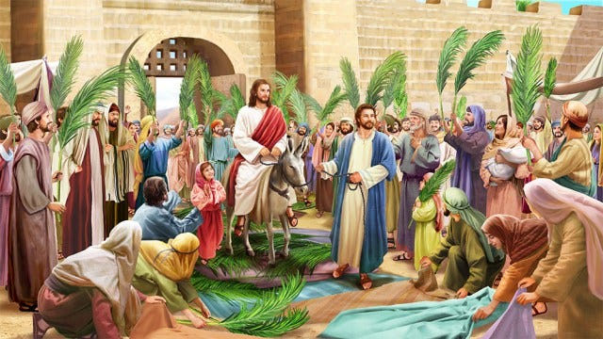
Matthew 21:5 (NLT)
“Tell the people of Jerusalem, ‘Look, your King is coming to you. He is humble, riding on a donkey— riding on a donkey’s colt.’ ”

Slide 3
Zechariah 9:9 (NKJV)
“Rejoice greatly, O daughter of Zion! Shout, O daughter of Jerusalem! Behold, your King is coming to you; He is just and having salvation, Lowly and riding on a donkey, A colt, the foal of a donkey.

Slide 4
Salvation is a moment in time, but his Kingship is for eternity.

Slide 5
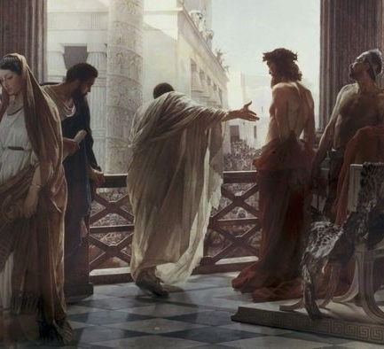
Denying His Kingship:
making Him less than he really is
not recognizing his authority to rule
indignant when one’s status is threatened
wanting to follow one’s own agenda
being influenced by peer pressure
disappointed because of wrong expectations
fear of the authorities over us
preferring someone else’s rule in our lives
making Him an object of ridicule, scorn, and abuse

Slide 6
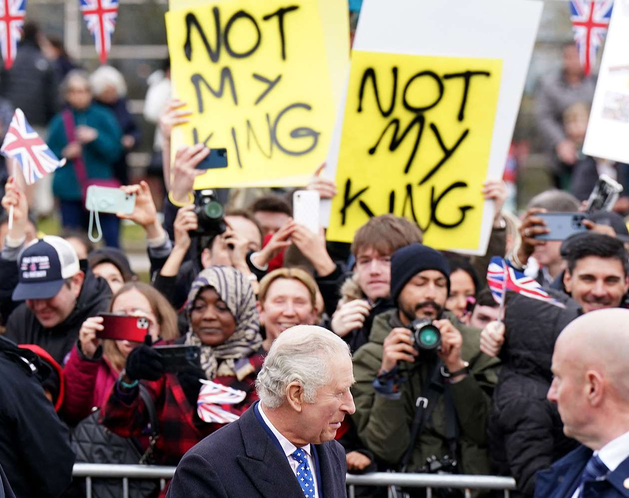
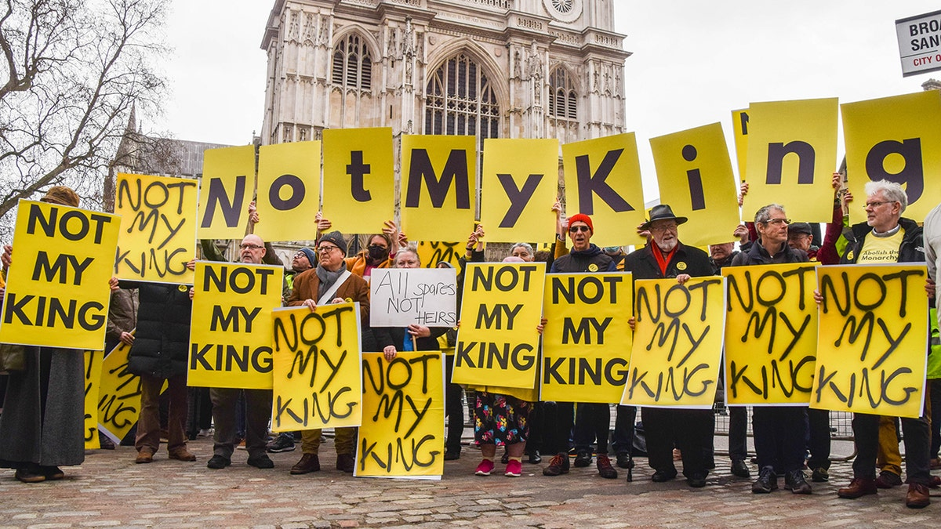

Slide 7
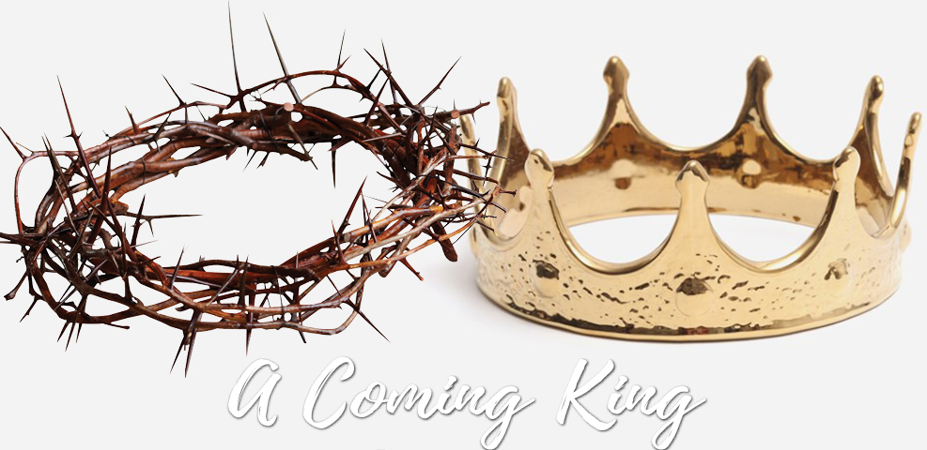
Matthew 21:5 (NLT)
“Tell the people of Jerusalem, ‘Look, your King is coming to you. He is humble, riding on a donkey— riding on a donkey’s colt.’ ”

